Slide 1

RobCoG
Srikanth Malineni

Slide 2
Speech Transcriptions
Natural Language Instructions
Procedure :
Speech-to-Text Transcriber
Intent and Entity Classification (RASA framework)
Transcriptions :
Sphinx plugin (Pocket Sphinx)
Speech plugin (Whisper API)
FLASK-REST API for Speech

Slide 3
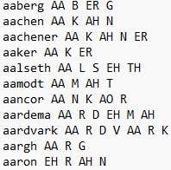

Speech Transcriptions
Sphinx Plugin (Pocket Sphinx)
Acoustic and Language Models
Phonetic Dictionary
Limitations :
Inaccurate for sentences
Phonetic vocabulary size
Phonemes
Language Model
(n-grams)
Acoustic Model
Decoder
TRANSCRIPTION
Parameters (eg. tolerance)

Slide 4
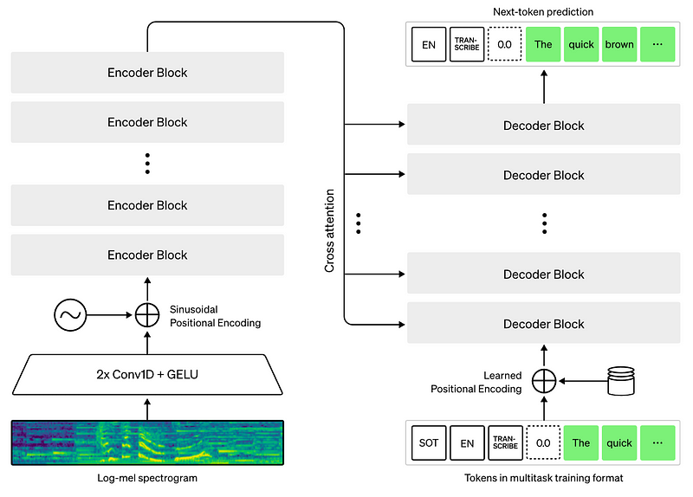
Speech Transcriptions
Unreal’s Speech Plugin using Whisper API
Unreal’s FRunnable and GGML tensor library
Digital audio processing
Log-Mel spectrograms
Limitations :
Speed vs Accuracy trade off
Takes 5-10 secs for transcriptions

Slide 5



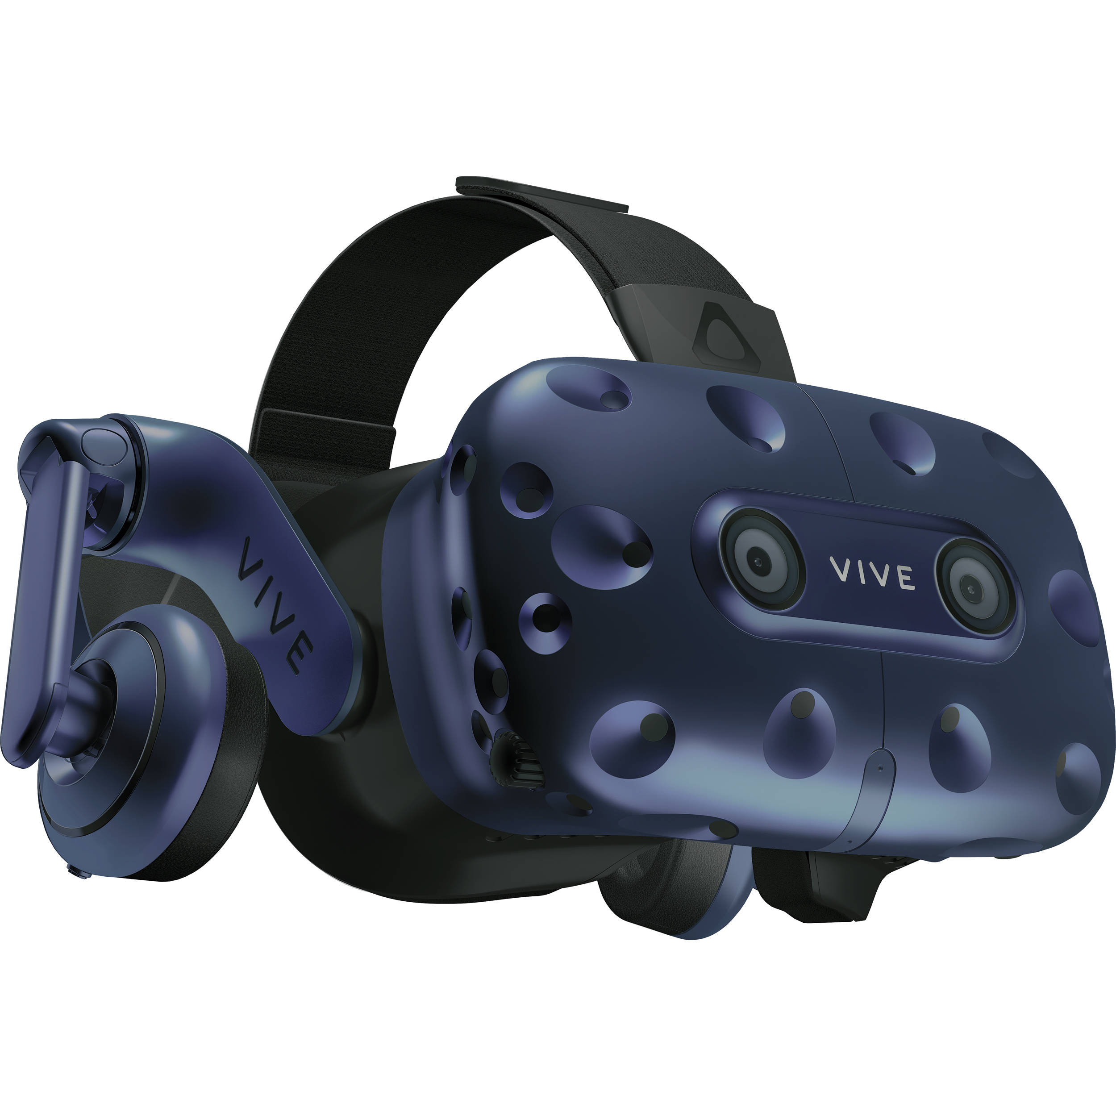
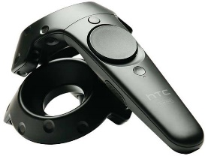
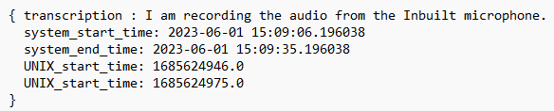
Speech Transcriptions
Hello
transcriptions(JSON)
Python Flask API (Local Host)
Controller mappings to trigger API calls to Flask
API requests to Start/Stop audio recordings
Transcriptions outside Unreal with Whisper API
Transcription response parsed inside Unreal
Whisper API
HTTP Response
Hello
PyAudio
HTTP Request
start, stop

Slide 6
Fluids
Pouring particle effects with different liquid types (water, batter, honey etc.,)
Techniques :
Niagara particle system (FPS issues)
Zibra Liquids AI
Liquid solver parameters
Viscosity, Particle density, Stiffness etc.,
Liquid material parameters
Colour, Opacity, Roughness etc.,

Slide 7
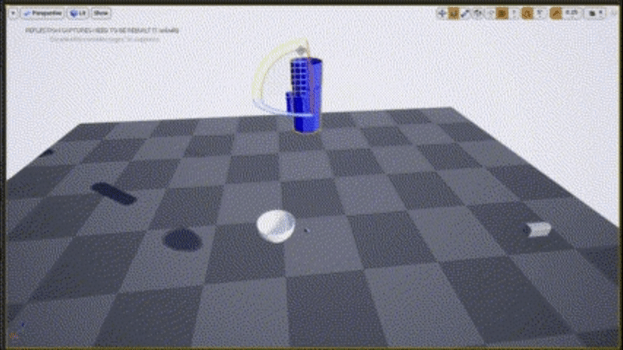
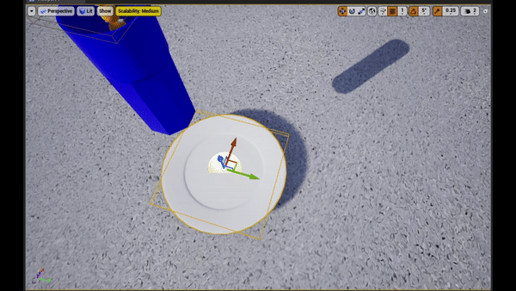
Fluids
GIFs: (a) Zibra Fluid pouring into a bowl (b) Pouring particles into a shape

Slide 8
AgeObSim
Enhancing VR Eye Logs in MongoDB
Plugins : SRanipal, UMongoC, USemLog
Location and Time statistics of the Gaze Actor
Eg. Other Actor (Name,ID), Hit Location and Time
Enhancing MC Hand Event Logs in MongoDB
Unpacking saved MongoDB collection in Python for statistical analysis

Slide 9
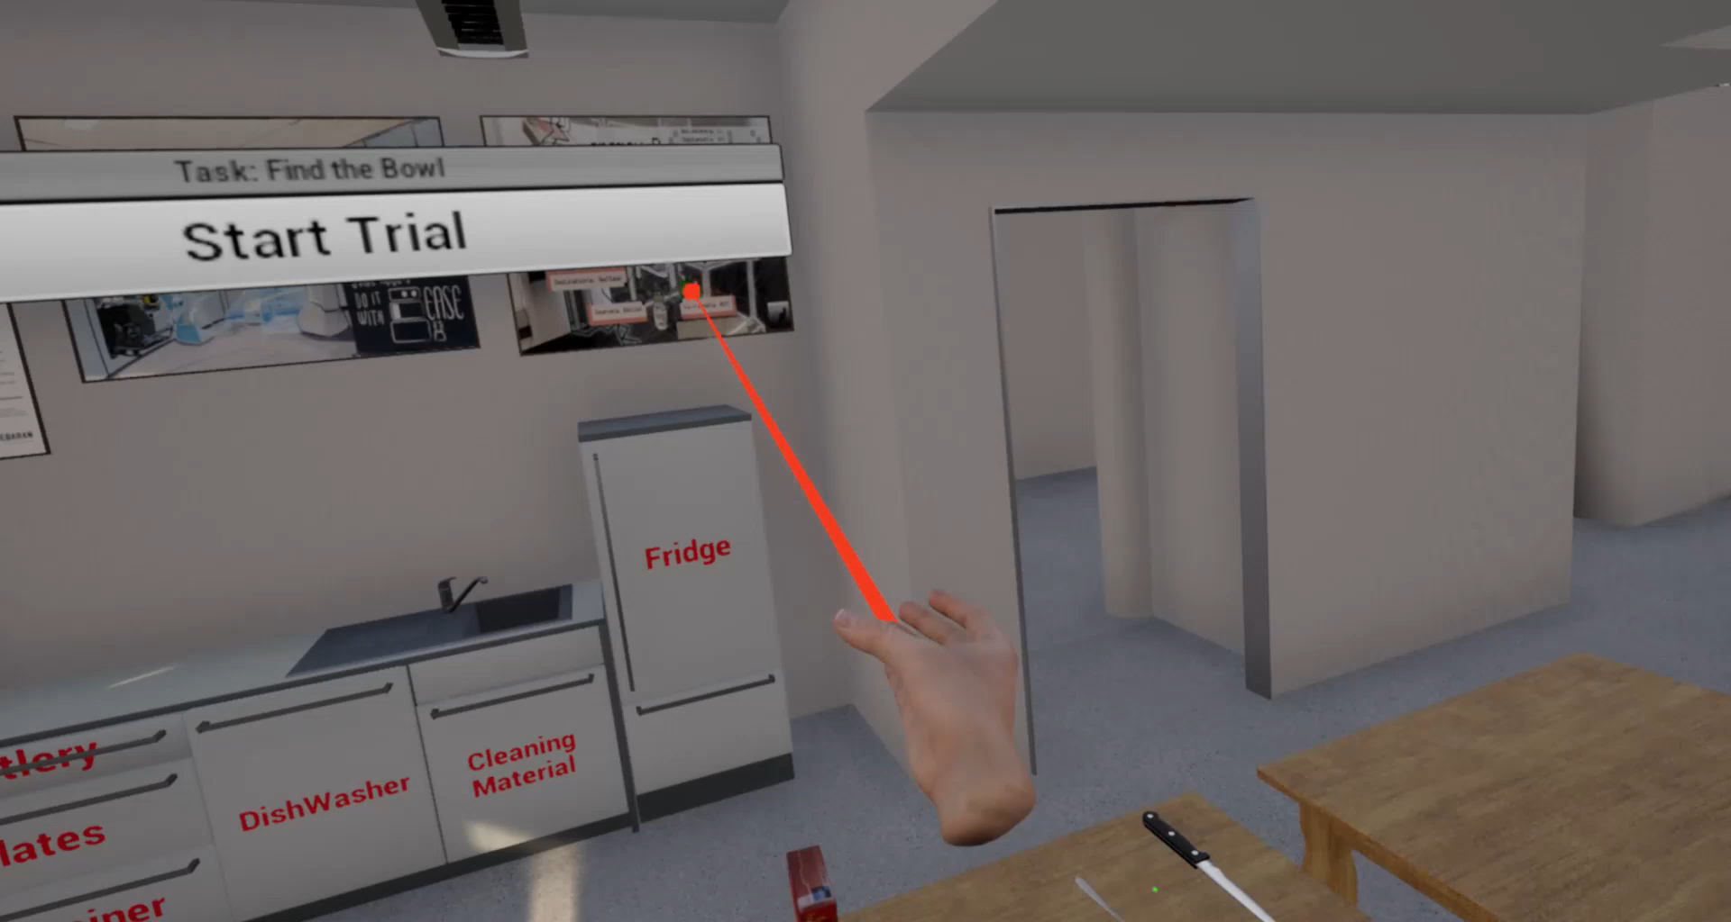
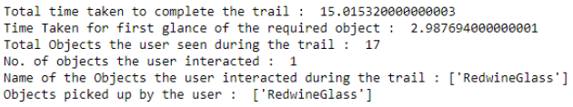
AgeObSim
Gaze Actor Movements in VR Kitchen

Slide 10
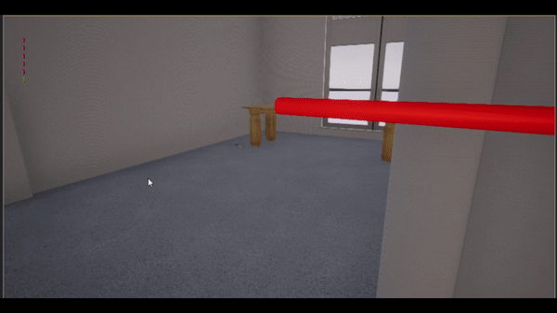
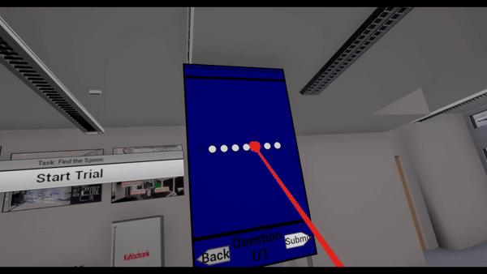
AgeObSim
Survey (feedback) mechanism
Spawning questionnaire widget for feedback
Directing player to the feedback widget
Save responses and destroy widget upon submit

Slide 11
Thesis
Predicting the Resources of Network Simulations (OOTB Simulator)
Peak Disk Used, Peak RAM Used and Time Taken
Dataset Creation and Cleaning, Feature Engineering and Selection
Model building, evaluation and optimization
Random Forest, XGBoost, ANN and Stacking models
https://dl.acm.org/doi/abs/10.1145/3458473.3458819
https://github.com/ComNets-Bremen/ops-on-the-bench

Slide 12
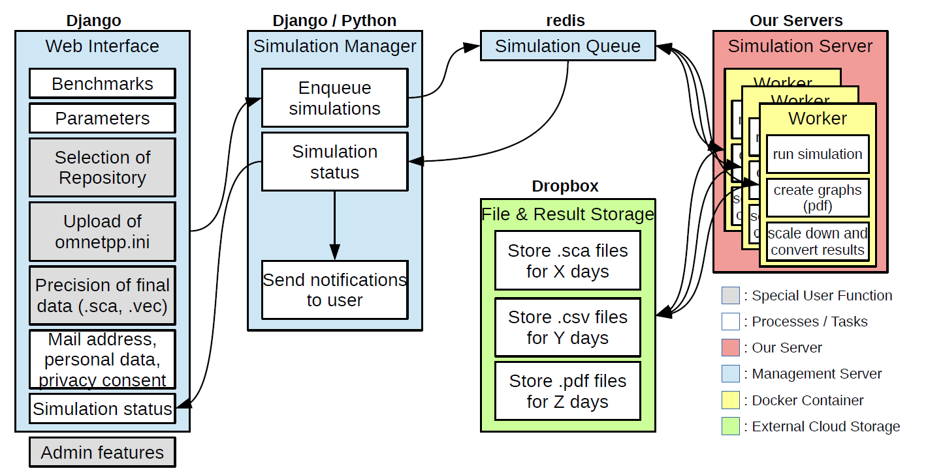
Thesis
Cron Job :
Efficiently Shuffle Queued Jobs based on Available Space on Server
Model Predictions and Decisions
(Django Form Wizards)
Fig. Architecture Overview of OOTB

Slide 13
THANK YOU

